Slide 1





Welcome to the Scientific Thought Training Sessions!
Team Latvia
During this session You will have some interesting illusions, that will reveal some amazing knowledge about how our brain works (specifically about our perception and thinking). And how to not fall for some typical cognitive (perceptual and thinking) biases.
START
This content works properly in slide show mode only!
To see figure attribution, click on the figure!
About
the project
Content
About us
References

Slide 2


Introduction. Thinking and science
Chapter 1. Perceptual illusions and naïve realism
Chapter 2. Illusions of thought
Chapter 3. Naïve realism vs scientific methods
Chapter 4. Two ways of thinking.
Chapter 5. Almost scientific thinking
Chapter 6. Logic
Chapter 7. Justified true belief and culture of discussion
Chapter 8. Critical thinking
References
Content
Home
START

Slide 3
Home
References
1. Altman N, Krzywinski M. (2015). Association, correlation and causation. Nat Methods. 2015 Oct;12(10):899-900. doi: 10.1038/nmeth.3587. PMID: 26688882.
2. Bajšanski, I., Žauhar, V., & Valerjev, P. (2019). Confidence judgments in syllogistic reasoning: the role of consistency and response cardinality. Thinking & Reasoning, 25(1), 14-47. doi:10.1080/13546783.2018.1464506.
3. Bensley, D. A. (2011). Rules for Reasoning Revisited: Toward a Scientific Conception of Critical Thinking. In C. P. Horvath, & J. M. Forte (Eds.), Critical Thinking (pp. 1-36). ProQuest Ebook Central https://ebookcentral.proquest.com.
4. Bensley, D. A., Lilienfeld, S. O., &amp; Powell, L. A. (2014). A new measure of
psychological misconceptions: Relations with academic background, critical thinking,
and acceptance of paranormal and pseudoscientific claims. Learning and Individual
Differences, 36, 9-18. doi:10.1016/j.lindif.2014.07.009.
5. Bunge, M. (2011). Knowledge: Genuine and Bogus. Science and Education, 20, 411-438. doi:10.1007/s11191-009-9225-3.
Next

Slide 4
Home
References
6. Elder, L., & Paul, R. (1996). Critical Thinking Development: A Stage Theory. Retrieved from Criticalthinking.org: https://www.criticalthinking.org/resources/articles/ctdevelopment-a-stage-theory.shtml
7. Evans, J. S., Barston, J. L., & Pollard, P. (1983). On the conflict between logic and belief in syllogistic reasoning. Memory & Cognition, 11, 295-306. Retrieved from https://datubazes.lanet.lv:4876/10.3758/BF03196976.
8. Foresman, G. A., Fosl, P. S., & Watson, J. C. (2016). The critical thinking toolkit. ProQuest Ebook Central https://ebookcentral.proquest.com.
9. Geffen, N. (2005). Echoes of Lysenko: State-Sponsored Pseudo-Science in South Africa. Social Dynamics, 31(2), 183-210. doi:10.1080/02533950508628713.
10. Jaiswal, J., LoSchiavo, C., & Perlman, D. C. (2020). Disinformation, Misinformation and Inequality-Driven Mistrust in the Time of COVID-19: Lessons Unlearned from AIDS Denialism. AIDS and Behavior, 24, 2776-2780. doi:10.1007/s10461-020-02925-y.
11. Kahneman, D. (2003). Maps of Bounded Rationality: Psychology for Behavioral Economics. The American Economic Review, 93(5), 1449-1475. doi:10.1257/000282803322655392.
Next

Slide 5
Home
References
12. Lack, C. W., & Rousseau, J. (2016). Critical Thinking, Science, and Pseudoscience : Why We Can't Trust Our Brains. ProQuest Ebook Central https://ebookcentral.proquest.com.
13. Markovits, H. (2014). Development and necessary norms of reasoning. Frontiers in Psychology, 488(5). doi:10.3389/fpsyg.2014.00488.
14. Pavlovskis, E. (2021). Changes in Students' Beliefs About Pseudoscientific Theories in the University Studies Process. Master Thesis, University of Latvia, 2021. https://dspace.lu.lv/dspace/handle/7/53965
15. Schulz, K. (2011, mar). On being wrong. Retrieved from TED.com: https://www.ted.com/talks/kathryn_schulz_on_being_wrong#t-169231
16. Shermer, M. (2006). Why People Believe Weird Things. TED talk 2006. https://www.ted.com/talks/michael_shermer_why_people_believe_weird_things
17. Simelela, N., Venter, W., Pillay, J., & Barron, P. (2015). A Political and Social History of HIV in South Africa. Current HIV/AIDS Reports, 12, 256-261. doi:10.1007/s11904-015- 0259-7.
18. Smith, P. C., & Vasquez, K. (2008). Teaching critical thinking about difficult topics. In D. S. Dunn, J. S. Halonen, & R. A. Smith (Eds.), Teaching Critical Thinking in Psychology : A Handbook of Best Practices (pp. 211-221). ProQuest Ebook Central https://ebookcentral.proquest.com.
19. Tsikata, P. Y., Pindi, G. N., & Anaele, A. (2016). The frozen rhetoric of AIDS denialism and the flourishing claims of a cure: A Comparative analysis of Thabo Mbeki and Yahya Jammeh‟s rhetoric. Communicatio, 42(3), 378-397. doi:10.1080/02500167.2016.1209535.

Slide 6

Home
Introduction.
Thinking and science. 1/5
By navigating and performing STEM (science, technology, engineering and math) related activities or any other science based activity, every student and professional is meant to subscribe somehow under the first letter of this abbreviation, the capital “S”. S stands for science. The basis of science is the scientific way of thinking and cooperating in the way that promotes scientific thought. Our brain, and cognitive abilities associated with it, is our main instrument for success or … failure.
Next
Scientific Thought Training Sessions

Slide 7

Introduction. Thinking and science. 2/5
Home
Our natural way of perceiving the world around us and thinking is very effective to satisfy our basic needs, when circumstances are like these, we are evolved to deal with (natural habitat, small groups only). It is not possible for us to be evolutionarily adapted to deal with the modern world – advanced technology, complex society, as these changes (like urbanization and industrialization) happened during just a few centuries.
Next
1 page back

Slide 8
Introduction. Thinking and science. 3/5
Home
Our natural way of perceiving the world around us and thinking is plagued with properties that are counterproductive, when we are on our way to understand things and processes around us, when we live in a world as it is today. The ultimate human problem is having a sense of always being right, of always having true beliefs, despite contrary evidence.
Next
1 page back

Slide 9
Introduction. Thinking and science. 4/5
Home
The solution number 1 for almost all global problems is to know ourselves better, to learn how to avoid unnecessary errors, false beliefs, bias (like racism, xenophobia etc.), waste of resources (like public policies based on pseudoscience), conflicts, man-made disasters (think – nuclear weapons). As we see, false beliefs can be very dangerous (330 thousand dead in few years just in one country due to false beliefs about health care issues (Geffen, 2005; Jaiswal, LoSchiavo, & Perlman, 2020; Simelela, Venter, Pillay, & Barron, 2015; Tsikata, Pindi, & Anaele, 2016) ).
Next
1 page back

Slide 10
Introduction. Thinking and science. 5/5
Home
Science as a progressive process, and scientific thinking is the way to overcome most issues with our limited and fallible perception, memory and thinking. Our effort could be especially valuable, as it is shown, that often even universities fail to provide adequate opportunities to learn to think critically and scientifically (Bensley, Lilienfeld, Powell, 2014; Pavlovskis, 2021). Acquisition of critical, scientific thinking and its regular use does not result in contempt for human emotions and values based on them, as some wrongly assume. As pressing global issues arise, clear, unbiased thinking is the way for sustainability and preservation of cultural and natural heritage.
Next
1 page back
Perceptual illusions and naïve realism

Slide 11

Chapter 1.
Perceptual illusions and naïve realism
Naïve realism is our tendency to trust our senses, our perceptions, memories and thoughts too much. Erroneously we regard our own experience as a more trustful and valuable source of information than any other (e.g. findings of scientific research meta-analysis). There is a lot of evidence that we, all of us, humans, are much more fallible than we think.
Home
Next

Slide 12
Beginning of the chapter
Chapter 1. Perceptual illusions and naïve realism 2/5
We all have a lot of false beliefs, but despite that fact, we always tend to think that we don’t hold any single believe that is false, and that is not justified. We seek, and we are responsive almost only to the information, that confirms our existing beliefs. This is confirmation bias. We are able to ignore massive amount of evidence against our cherished beliefs. This is the number one reason why we need science as a very special fact finding process, that greatly differs from the natural thinking of an individual. In chapter 3 You will find an example of what difference this makes.
Home
Next
1 page back
Team Latvia

Slide 13
Beginning of the chapter
We will start with some simple visual experiments and illusions, and then will proceed to thinking irregularities common to all of us. Aim of these activities is not to discourage You making your own observations and conclusions, but to equip You with some necessary knowledge of how extensive problem naïve realism is, and how to overcome problems associated with it. And don’t be fooled into any form of anti-realism either. For to stay on reasonable discourse, we still have to acknowledge (or at least assume) that we have some indirect, limited and imperfect access to objective reality out there, that is common to all of us.
Home
1 page back
Next
Chapter 1. Perceptual illusions and naïve realism 3/5

Slide 14
Chapter 1. Perceptual illusions and naïve realism 4/5
Just theoretically acknowledging, that sometimes we are wrong, doesn’t makes our thinking any better (Nice and simple intro to this problem by Kathryn Schulz, journalist who appoints herself to be a professional “wrongologist”: https://www.ted.com/talks/kathryn_schulz_on_being_wrong (Schulz, 2011). Simple logic and scientific research in cognitive psychology upholds main statements made by her). There are a lot of known psychological effects revealing that our brain lulls us into believing that we are right no matter what. That everything always is ok with our way of perceiving things and thinking about them, no matter what available evidence says.
1 page back
Beginning of the chapter
Next

Slide 15
Chapter 1. Perceptual illusions and naïve realism 5/5
This could manifest in You believing that there is something special, something wrong with those pictures and tasks shown to You now, and that there is nothing odd about yourself. When the truth is – there is nothing special about these pictures and tasks, but there are many things special about You (us – humans), which is better to be familiar with.
Beginning of the chapter
1 page back
Next

Slide 16
Chapter 1. Perceptual illusions and naïve realism
1.1 Visual illusions
Try to catch your very first thoughts, when seeing
This Picture
Beginning of the chapter
1 page back

Slide 17
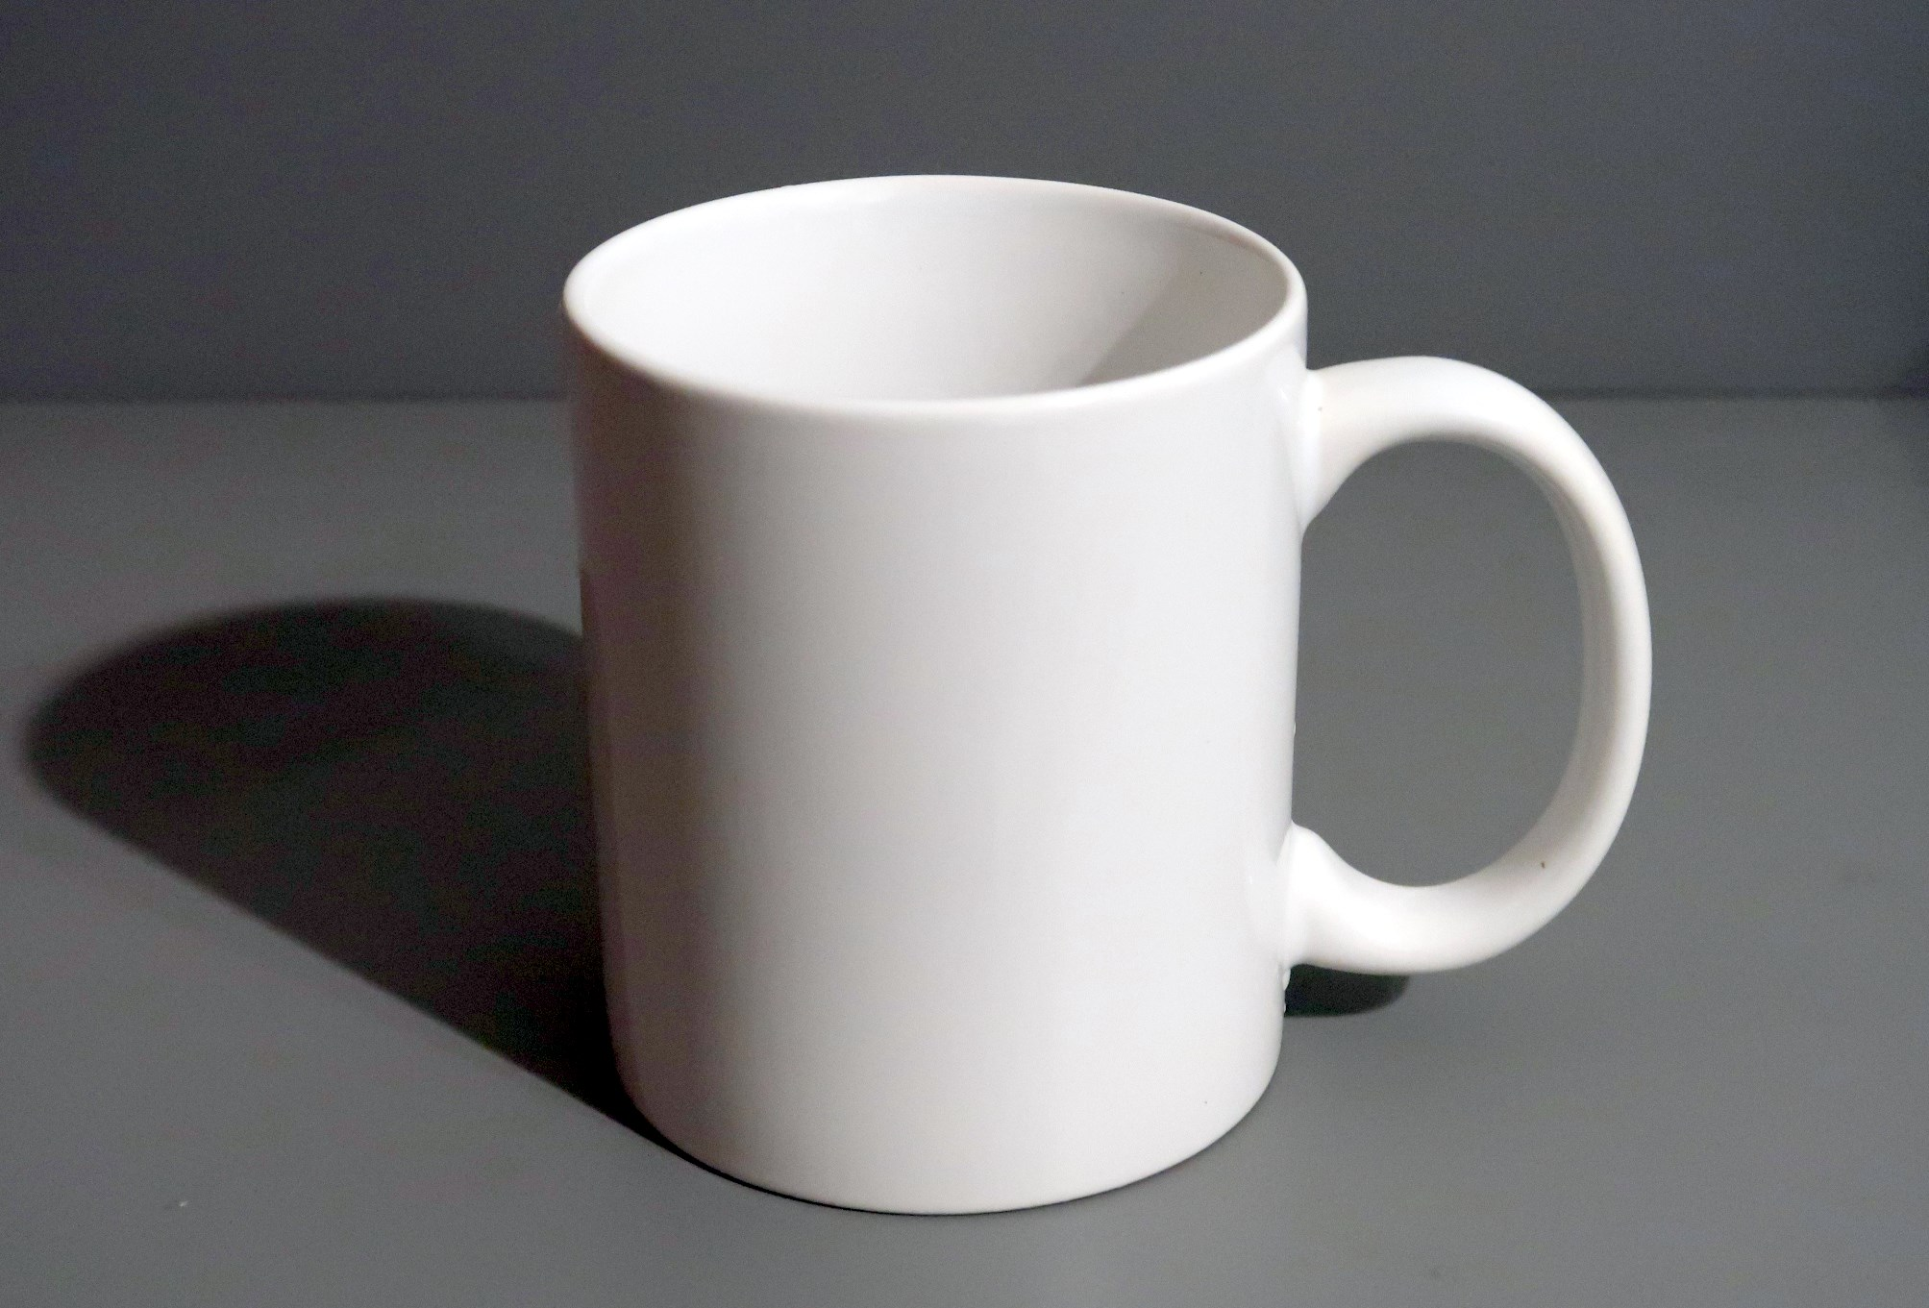
Next
Chapter 1. Perceptual illusions and naïve realism
Figure 1

Slide 18
Beginning of the chapter
Chapter 1. Perceptual illusions and naïve realism
Despite the fact that this really is just a picture of a mug, the way how we perceive it is quite amazing. Usually a concept of “a mug” just pops up in our conscious mind (Where it comes from? Of course, from the unconscious part of our mind, and not directly from observable reality around us, nor the information that our brain gets from the retina of our eyes! More on that in chapter 4). Concept of a mug is somewhat more complicated, that something observable as “white, shiny object”, or “something like a cylinder with an appendix”. It seems that our brain is trying to match observable reality with some list of predefined object categories we are familiar with.
Home
1 page back
Next
Scientific Thought Training Sessions

Slide 19
Beginning of the chapter
Chapter 1. Perceptual illusions and naïve realism
This is not like asking “what are the observable properties of an object, and based on these observations trying to figure out, what it could be?” Even if the object is distant and not easily discernible, that’s more like “It should be something! Is this X, or maybe Y?” To prioritize options of significance and familiarity in the involuntary process of recognition, turns out to be a very successful strategy. But, of course, sometimes it skews our perception, as we are more biased towards the recognition of familiar types of objects.
Home
1 page back
Next
Scientific Thought Training Sessions

Slide 20
Chapter 1. Perceptual illusions and naïve realism
Very common and effective strategy of our perception (unconscious process) and thinking (both conscious and unconscious processes) is using an analogy, but it is almost always at odds with logic. Thinking by analogy differs from logical thinking by the following type of assumption. If an object (or system) A has properties X, Y and Z, then an object (or system) B, that has properties X and Y, is assumed to also have property Z. Analogy is one of the so-called thinking heuristics or thinking shortcuts – a way how to get results very fast, without much effort, but with a price – lowered reliability.
1 page back
Next
Scientific Thought Training Sessions

Slide 21
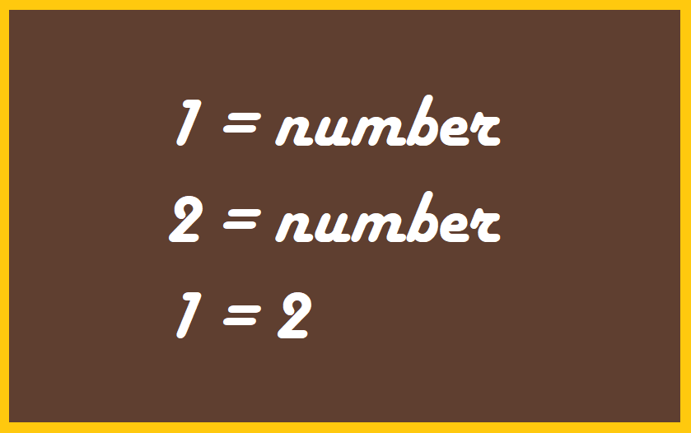

Beginning of the chapter
Chapter 1. Perceptual illusions and naïve realism
This one also is an analogy, not very strong analogy…
Home
1 page back
Next

Slide 22

Start of chapter
Chapter 1. Perceptual illusions and naïve realism
Beginning of the chapter
What do You see here?
Home
Next:
Explanation
1 page back
Figure 2

Slide 23

Start of chapter
Chapter 1. Perceptual illusions and naïve realism
Beginning of the chapter
Do You see a bright white triangle, as we do? But is it really there? We are even having a false feeling of somewhat different shade of gray outside of the imaginable triangle, but is there any triangle at all in this picture? There are only imagined triangles in our mind.
We are very prone to make connections between points. (Not only between visual points, but also events separated by time intervals etc.)
Home
1 page back
Next
Scientific Thought Training Sessions

Slide 24
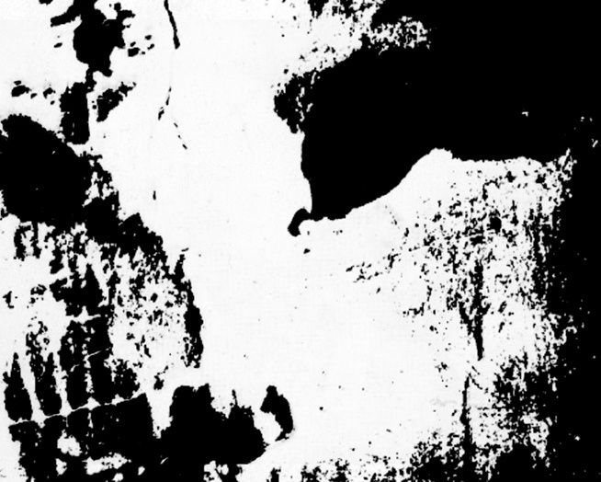
Beginning of the chapter
What do You see in this picture?
For most people it is hard to see anything in this picture.
Home
Check
this out
Chapter 1. Perceptual illusions and naïve realism
Figure 3

Slide 25
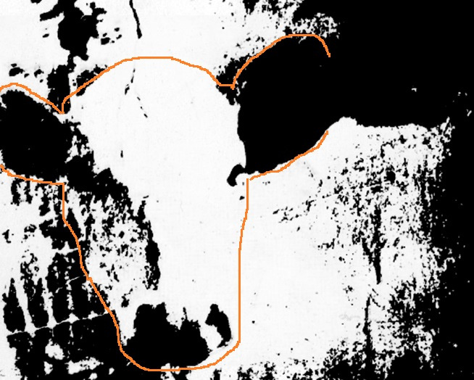
Start of chapter
1 page back
Beginning of the chapter
Home
When we are given a clue, it is easy now to see a cow. But when You are given a clue, You can’t “unsee” a cow, to ever go back to the previous state of mind. There is a similarity with thinking bias called “curse of knowledge”. This is when you know things, that the other person does not, and you have forgotten what it’s like to not have this knowledge. Also somewhat relevant here could be a false sense of predictability of events that have already happened, usually associated with expressions like: “I knew it all the way”!
Figure 4
Next

Slide 26

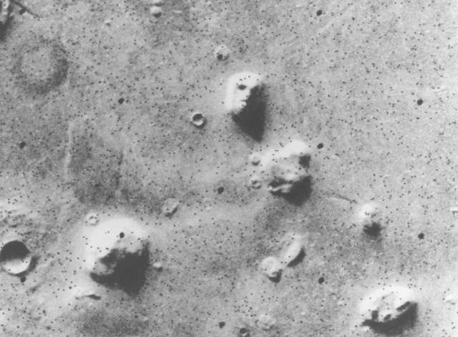

Chapter 1. Perceptual illusions and naïve realism
Pareidolia is whereas the brain perceives a familiar pattern where there is none. We have a very profound tendency to see faces everywhere (e.g. emoji). This is a famous “face on Mars” pictured by NASA Viking-2 Mars lander in 1976.
Look
closer
Figure 5

Slide 27
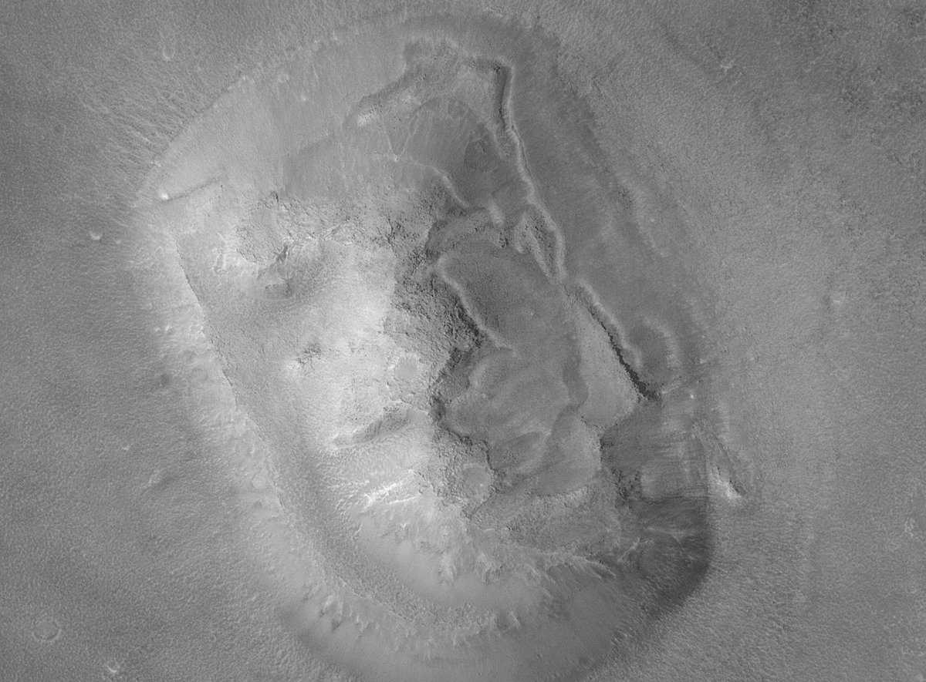
Chapter 1. Perceptual illusions and naïve realism
Beginning of the chapter
NASA has been hard pressed by the public to examine this feature closer during the next martian mission. When we can have a closer look, the illusion is almost gone… (Shermer, 2006)
Home
1 page back
Next
Figure 6

Slide 28

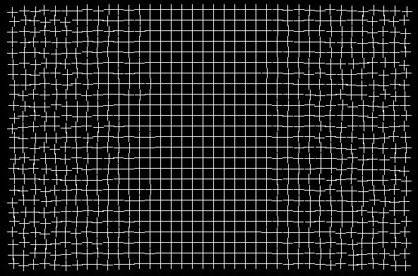
Chapter 1. Perceptual illusions and naïve realism
It seems that our brain has some preference for regular patterns over irregular ones, and it redraws visual scenes according to that preference. As you stare at the center of the grid, the regularity of the grid pattern at the center spreads into the irregular parts in the periphery.
Explanation
Figure 7

Slide 29
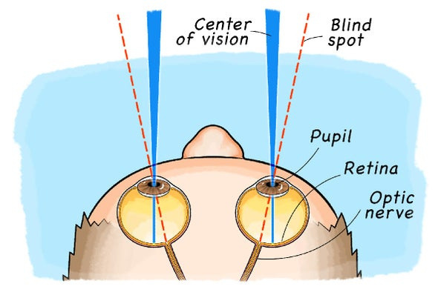
Beginning of the chapter
Chapter 1. Perceptual illusions and naïve realism
One explanation is that this might be because of the necessity to mask our visual blind spots. There are two of them, one per eye. This is where optic nerves connect to the retina, because of lack of photosensitive cells here.
Home
Figure 8
1 page back
Try it yourself!
Scientific Thought Training Sessions

Slide 30

Chapter 1. Perceptual illusions and naïve realism
Start of chapter
Beginning of the chapter
Cover your left eye and look at the plus sign, move closer or further away to find where the circle disappears.
Home
1 page back
Next

Slide 31
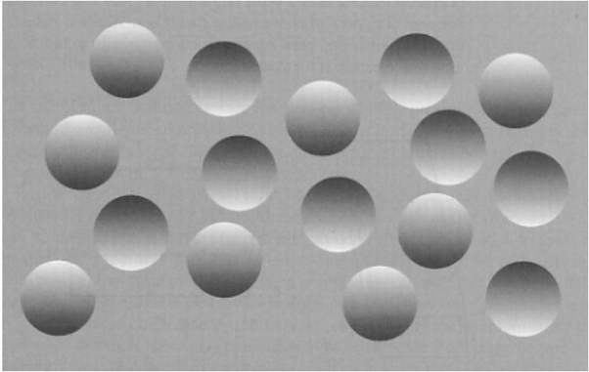
Figure 9
Start of chapter
Beginning of the chapter
Our perception includes specific assumptions about how things should be. If they are not met, there will be an error. In particular, there is a natural assumption that the world is in 3D (not flat), and that there is one source of light, and it shines from above. What do You see in this picture? It seems that there are some concave and convex circles on the surface. First of all, we know that this picture is on a flat computer screen, so everything here is flat. And then – turn your screen upside down! What has happened to the picture?
Home
1 page back
Our brain gets some cues about what to see here from the areas of different shades of grey, seemingly representing shadows.
Next

Slide 32
Start of chapter
Chapter 1. Perceptual illusions and naïve realism
Beginning of the chapter
And then there are types of objects we are not able to see properly, counterintuitive ones, like Necker cube or …
watch this:
Home
https://www.youtube.com/watch?v=ORoTCBrCKIQ
1 page back
Next
Scientific Thought Training Sessions

Slide 33
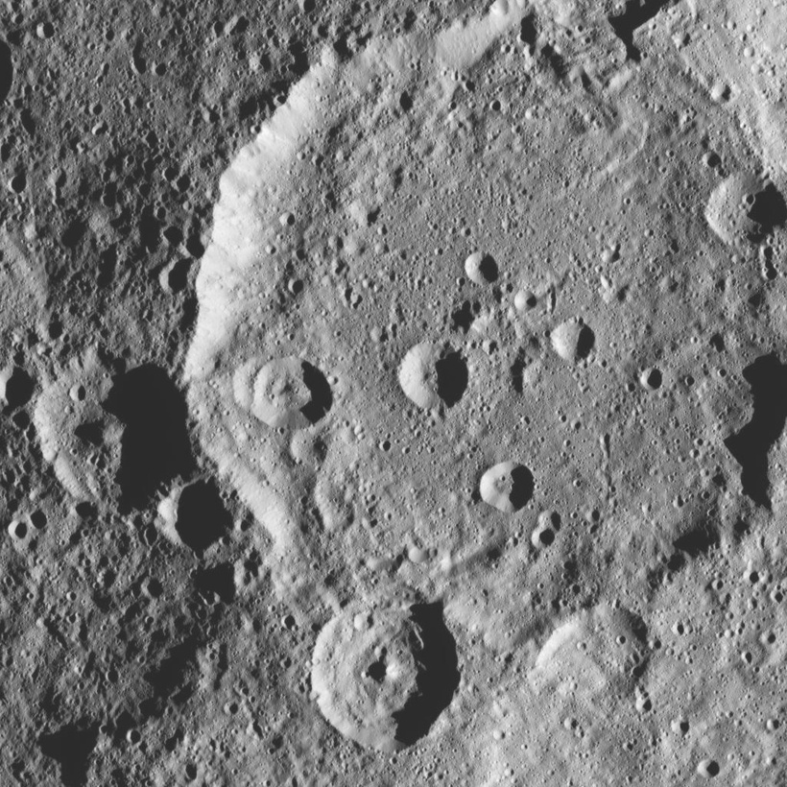
Chapter 1. Perceptual illusions and naïve realism
Start of chapter
Beginning of the chapter
This is why we have a hard time to make sense of some photos, like those from other planets. With some patience You could switch between seeing alternatively craters or bulges in this picture.
Home
1 page back
Next
Figure 10

Slide 34
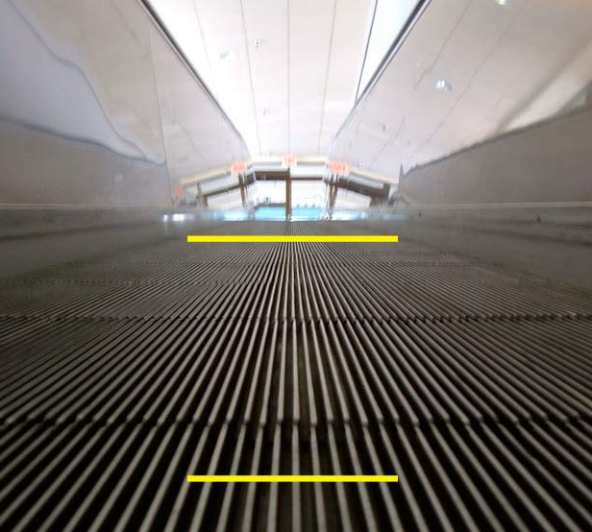
Start of chapter
Figure 11
Beginning of the chapter
We have a visual 3D representation of the world despite the fact that the optical image on the retina of an eye is two dimensional. Brain reconstructs 3D reality employing some rules or assumptions. Objects that occlude other objects are the closest ones. Objects occlude other objects in a figure/ground hierarchy, and the visual brain must perceptually complete occluded features. The mechanisms underlying figure-ground segregation and object-completion employ filling-in, leading to some spectacular effects (e.g., illusory contours, Kanizsa triangle). And there are the rules of lines of perspective. Which yellow line is longer in this picture?
Home
1 page back
Next

Slide 35
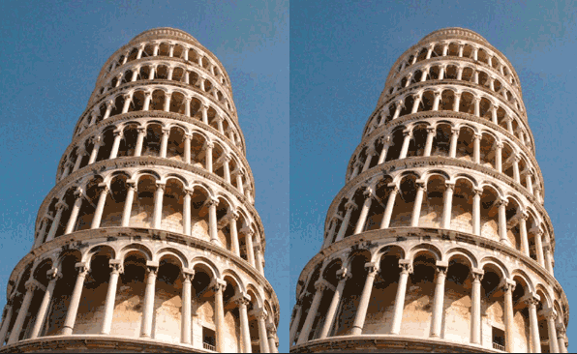
Chapter 1. Perceptual illusions and naïve realism
Which one of the Pisa towers is leaning more to the right?
Explanation
Figure 14

Slide 36
Beginning of the chapter
These are two identical pictures side by side. The problem is, that we tend to perceive this as a one picture that should represent reality – two neighboring towers. By the rules of perspective, upper parts of towers (as “we are standing” quite close to the bases of the towers) are further away from us, and thus should look closer together. If they are not, our brain considers that there is something wrong with the tower. As we see, if the tower on the left is already leaning to the right, than the tower on the right should be leaning to the right even more.
Home
1 page back
Next
Team Latvia

Slide 37


Chapter 1. Perceptual illusions and naïve realism
Most of how our perception works, and as a result, what we perceive is dependent on processes we do not have access to, and knowledge about. If not for unconscious micro motions of our eyes scanning scenes around us all the time, we would have tunnel vision (try to stare at one point!), where everything is blurry except the tiny speck in the center of visual field. There are some internal laws of how these micro motions are executed. And there are some circumstances, when this system could be fooled.
Look at this!
Scientific Thought Training Sessions

Slide 38
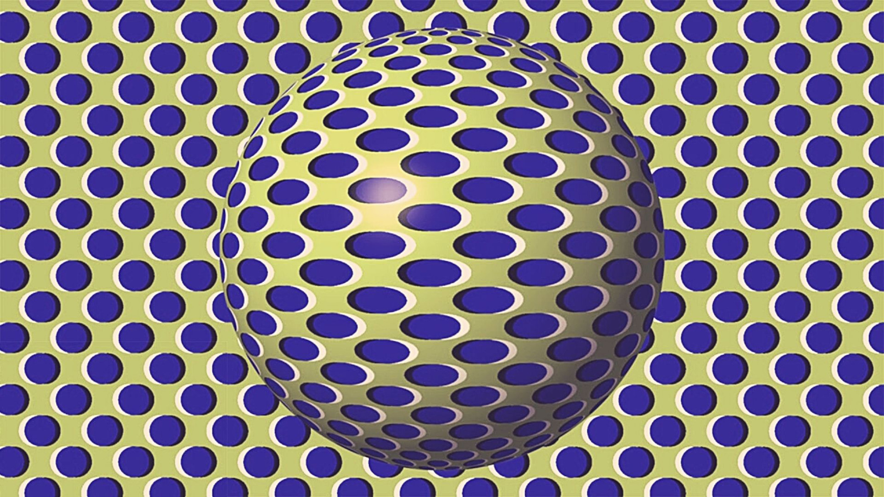
Start of chapter
Chapter 1. Perceptual illusions and naïve realism
Beginning of the chapter
Home
Figure 13: Illusion of motion
Next
1 page back

Slide 39
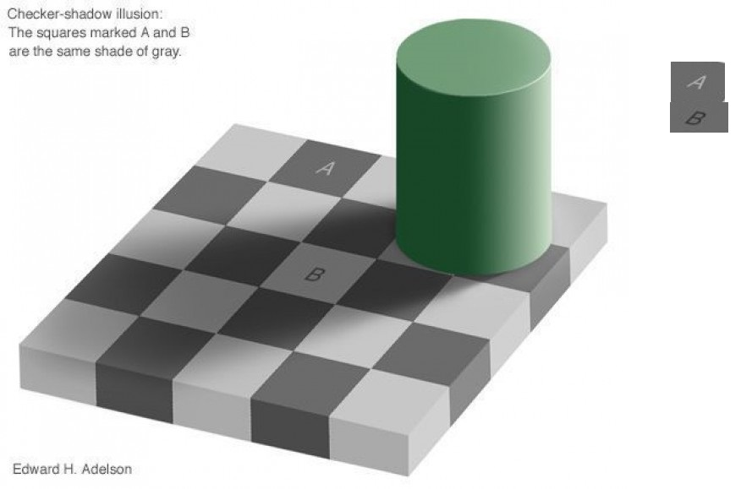
Start of chapter
Beginning of the chapter
Our perception is very adaptive to some natural standard situations e.g. compensating for perceived brightness of objects apparently situated in the shade.
so there is more proof to it
Home
Figure 14
Squares “A” and “B” are the same shade of grey! It is a very strong illusion, so You could do as we did – see the copied and pasted squares on the right? Even then it’s hard to believe,
1 page back

Slide 40
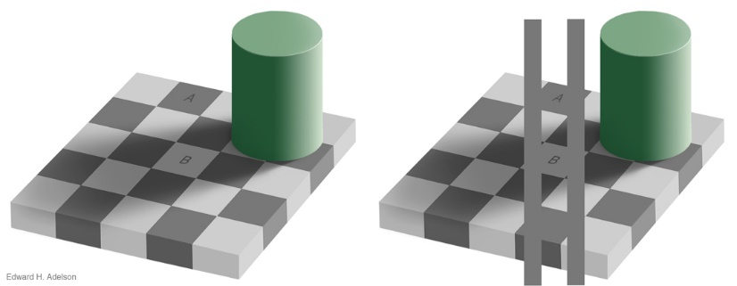
Start of chapter
Chapter 1. Perceptual illusions and naïve realism
Beginning of the chapter
Home
Figure 15
1 page back
Next
Scientific Thought Training Sessions

Slide 41
Beginning of the chapter
1.2 Other perceptual illusions.
Auditory illusions
Remember pareidolia, that is whereas the brain perceives a familiar pattern where there is none (e.g. faces)? Same thing happens in other sensory modalities of human perception. If You have ever spent some prolonged time at the sea, say, stayed in tent on the desolated beach overnight, or in other circumstances, where there is a high level of noise (especially that one “shhhhhh..” close to so called white noise), you would be soon realizing, that you are having auditory hallucinations. Hearing distant voices, barking dogs etc., which are not there.
Home
1 page back
Next
Team Latvia

Slide 42
Beginning of the chapter
This is normal, as the brain is trying to make sense of the auditory input it receives. Received stimuli is a random noise, and with a lot of random input, you could always find some samples that resemble something meaningful. There were always charlatans or just gullible folks claiming that it is possible to hear voice of deceased person, spirits etc., you just have to listen to some source of noise (like radio tuned in between the stations, or recording wind noise etc).
Home
1 page back
Next
Team Latvia
Scientific Thought Training Sessions

Slide 43
Start of chapter
Chapter 1. Perceptual illusions and naïve realism
Beginning of the chapter
Like with visual stimuli (remember a cow!) we have a priming effect (we see what we are expecting to see) for auditory stimuli also. For a good presentation of that effect watch this part of prof.
Michael Shermer lecture:
Home
https://www.ted.com/talks/michael_shermer_why_people_believe_weird_things?language=en#t-518732
1 page back
Next
Scientific Thought Training Sessions

Slide 44
Start of chapter
Chapter 1. Perceptual illusions and naïve realism
Beginning of the chapter
Next type of auditory (and other sensory) illusions is caused by mixing of sensory domains, e.g. vision, hearing, touch, smell, taste, proprioception (allows perceiving posture, e.g. you could tell where your hand is, with an eyes shut). To make sense of real world objects around us, it is necessary to integrate separate forms of sensation. Thus it is possible to build a somewhat coherent mental image of those objects (think, poo – is it only appearance that matters?;). But usually during such a process some information is lost, some replaced from other sensory domains etc. This process could cause false perceptions, illusions. Few examples follow.
Home
1 page back
Next
Scientific Thought Training Sessions

Slide 45
Start of chapter
Chapter 1. Perceptual illusions and naïve realism
Beginning of the chapter
Examples of when what you see influences, what you hear (McGurk effect), and when what you hear influences, what you see (Sound induced flash illusion) could be enjoyed here:
Home
https://www.youtube.com/watch?v=kzo45hWXRWU
Good example of mixing another sensory modalities is the “rubber hand illusion” (You could find it on the web).
1 page back
Next
Scientific Thought Training Sessions

Slide 46
Home
Chapter 2
Illusions of thought
What kind of logic do we really apply, when we think that we think in a logical manner? Even when we are trying hard to draw some logical conclusions, is this really logic?
Try this one!
1 page back
Team Latvia

Slide 47
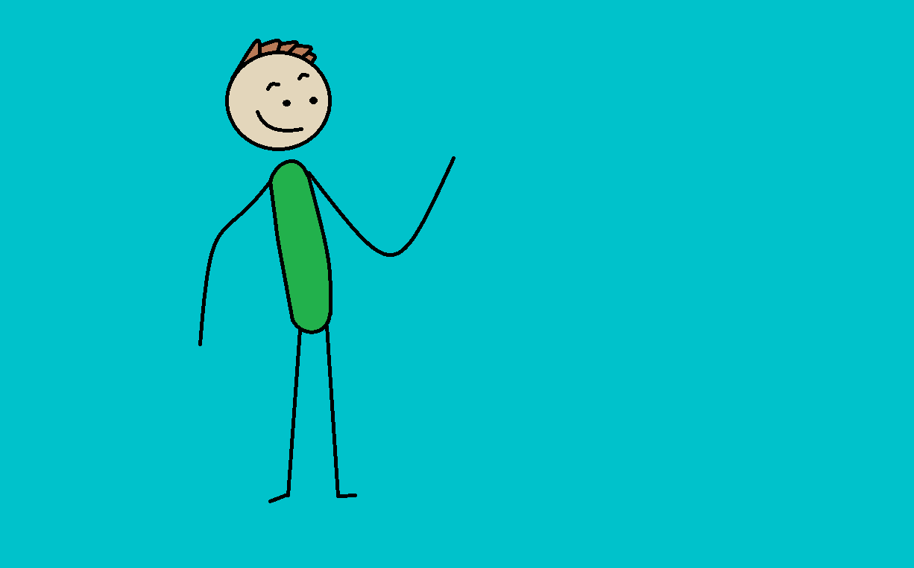
Brian has an office in the city. He has loved animals since he was a kid. He does his work on alive species. He sometimes needs to work in emergency situations.
Arrange the following statements in
order according to how likely they are
(1.: most likely, … , 4.: least likely).
Brian is an athlete.
Brian is a doctor.
Start by clicking on the most likely answer.
Brian is a veterinarian and an athlete.
Brian is a veterinarian.
Beginning
of the
chapter
Home

Slide 48
Brian has an office in the city. He has loved animals since he was a kid. He does his work on alive species. He sometimes needs to work in emergency situations.
Now click on the second most likely answer.
Brian is an athlete.
Brian is a doctor.
Brian is a veterinarian and an athlete.
Beginning
of the
chapter
Home

Slide 49
Brian has an office in the city. He has loved animals since he was a kid. He does his work on alive species. He sometimes needs to work in emergency situations.
Now click on the third most likely answer and leave the fourth most likely answer.
Brian is a doctor.
Brian is a veterinarian and an athlete.
Beginning
of the
chapter
Home

Slide 50
Brian has an office in the city. He has loved animals since he was a kid. He does his work on alive species. He sometimes needs to work in emergency situations.
Now click on the third most likely answer and leave the fourth most likely answer.
Brian is an athlete.
Brian is a veterinarian and an athlete.
Beginning
of the
chapter
Home

Slide 51
Brian has an office in the city. He has loved animals since he was a kid. He does his work on alive species. He sometimes needs to work in emergency situations.
Now click on the second most likely answer.
Brian is a veterinarian.
Brian is a doctor.
Brian is a veterinarian and an athlete.
Beginning
of the
chapter
Home

Slide 52
Brian has an office in the city. He has loved animals since he was a kid. He does his work on alive species. He sometimes needs to work in emergency situations.
Now click on the third most likely answer and leave the fourth most likely answer.
Brian is a doctor.
Brian is a veterinarian and an athlete.
Beginning
of the
chapter
Home

Slide 53
Brian has an office in the city. He has loved animals since he was a kid. He does his work on alive species. He sometimes needs to work in emergency situations.
Now click on the third most likely answer and leave the fourth most likely answer.
Brian is a veterinarian.
Brian is a veterinarian and an athlete.
Beginning
of the
chapter
Home

Slide 54
Brian has an office in the city. He has loved animals since he was a kid. He does his work on alive species. He sometimes needs to work in emergency situations.
Now click on the second most likely answer.
Brian is a veterinarian.
Brian is an athlete.
Brian is a veterinarian and an athlete.
Beginning
of the
chapter
Home

Slide 55
Brian has an office in the city. He has loved animals since he was a kid. He does his work on alive species. He sometimes needs to work in emergency situations.
Now click on the third most likely answer and leave the fourth most likely answer.
Brian is a veterinarian.
Brian is a veterinarian and an athlete.
Beginning
of the
chapter
Home

Slide 56
Brian has an office in the city. He has loved animals since he was a kid. He does his work on alive species. He sometimes needs to work in emergency situations.
Now click on the third most likely answer and leave the fourth most likely answer.
Brian is an athlete.
Brian is a veterinarian and an athlete.
Beginning
of the
chapter
Home

Slide 57
Brian has an office in the city. He has loved animals since he was a kid. He does his work on alive species. He sometimes needs to work in emergency situations.
Now click on the second most likely answer.
Brian is an athlete.
Brian is a doctor.
Brian is a veterinarian.
Beginning
of the
chapter
Home

Slide 58
Brian has an office in the city. He has loved animals since he was a kid. He does his work on alive species. He sometimes needs to work in emergency situations.
Now click on the third most likely answer and leave the fourth most likely answer.
Brian is an athlete.
Brian is a veterinarian.
Beginning
of the
chapter
Home

Slide 59
Brian has an office in the city. He has loved animals since he was a kid. He does his work on alive species. He sometimes needs to work in emergency situations.
Now click on the third most likely answer and leave the fourth most likely answer.
Brian is an athlete.
Brian is a doctor.
Beginning
of the
chapter
Home

Slide 60
Brian has an office in the city. He has loved animals since he was a kid. He does his work on alive species. He sometimes needs to work in emergency situations.
Now click on the third most likely answer and leave the fourth most likely answer.
Brian is a veterinarian.
Brian is a doctor.
Beginning
of the
chapter
Home

Slide 61


The order of your answers was :
Brian is a veterinarian.
Brian is an athlete.
Home
Brian is a veterinarian and an athlete.
Brian is a doctor.
We have good and bad news for You!
Which one You’d like to know first?
Good
Bad

Slide 62
The order of your answers was :
Brian is a veterinarian.
Brian is an athlete.
Home
Brian is a doctor.
Brian is a veterinarian and an athlete.
We have good and bad news for You!
Which one You’d like to know first?
Good
Bad

Slide 63
The order of your answers was :
Brian is a veterinarian.
Brian is a doctor.
Home
Brian is an athlete.
Brian is a veterinarian and an athlete.
We have good and bad news for You!
Which one You’d like to know first?
Good
Bad

Slide 64
The order of your answers was :
Brian is an athlete.
Brian is a doctor.
Home
Brian is a veterinarian.
Brian is a veterinarian and an athlete.
We have good and bad news for You!
Which one You’d like to know first?
Good
Bad

Slide 65
The order of your answers was :
Brian is an athlete.
Brian is a veterinarian.
Home
Brian is a doctor.
Brian is a veterinarian and an athlete.
We have good and bad news for You!
Which one You’d like to know first?
Good
Bad

Slide 66
The order of your answers was :
Brian is an athlete.
Brian is a veterinarian.
Home
Brian is a veterinarian and an athlete.
Brian is a doctor.
We have good and bad news for You!
Which one You’d like to know first?
Good
Bad

Slide 67
The order of your answers was :
Brian is a doctor.
Brian is a veterinarian.
Home
Brian is an athlete.
Brian is a veterinarian and an athlete.
We have good and bad news for You!
Which one You’d like to know first?
Good
Bad

Slide 68
The order of your answers was :
Brian is a doctor.
Brian is an athlete.
Home
Brian is a veterinarian.
Brian is a veterinarian and an athlete.
We have good and bad news for You!
Which one You’d like to know first?
Good
Bad

Slide 69


Home
We have good and bad news for You!
Which one You’d like to know first?
Good
Bad

Slide 70
Home
Bad News
You are wrong! This could not be logical, as there is no way that a probability to satisfy two conditions at a time (Brian is a vet and an athlete) could be greater than for one separate condition (a vet or an athlete).
What are the good news?

Slide 71
Home
Good News
This is normal. At least 85% of people fall for this thinking shortcut (heuristic), known as representativeness heuristic that causes conjunction fallacy during this task. That doesn’t mean that those, who answered right, don’t have this tendency.
Next

Slide 72
Home
Good News
This is normal. At least 85% of people fall for this thinking shortcut (heuristic), known as representativeness heuristic that causes conjunction fallacy during this task. That doesn’t mean that they, who answered right, don’t have this tendency, or even that they used proper logic.
What are the bad news?

Slide 73
Home
Bad News
You are wrong! This could not be logical, as there is no way that a probability to satisfy two conditions at a time (Brian is a vet and an athlete) could be greater than for one separate condition (a vet or an athlete).
Next

Slide 74
Home
Bad News
At least 85% of people fall for this thinking shortcut (heuristic), known as representativeness heuristic that causes conjunction fallacy during this task. Most of the time correct answers are due to random chance (guessing) and not proper logic. But even if You used proper logic here, that doesn’t mean that You don’t have this heuristic!
What are the good news?

Slide 75



Home
Good News
You are right! Probability to satisfy two conditions at a time (Brian is a vet and an athlete) is always lower than for one separate condition (a vet or an athlete).
Next

Slide 76
Home
Good News
You are right! Probability to satisfy two conditions at a time (Brian is a vet and an athlete) is always lower than for one separate condition (a vet or an athlete).
What are the bad news?

Slide 77
Home
Bad News
At least 85% of people fall for this thinking shortcut (heuristic), known as representativeness heuristic that causes conjunction fallacy during this task. Most of a time correct answers are due to the random chance (guessing) and not proper logic. But even if You used a proper logic here, that doesn’t mean that You don’t have this heuristic!
Next

Slide 78
Beginning of the chapter
Chapter 2. Illusions of thought
OK, then You may ask, why say 15% of people do this task right?
This could be done by chance, by using proper logic, and by using wrong logic plus chance. First of all, there are 24 ways to arrange 4 answers, 8 of them are correct answers (every answer where option “C” is ranked lower than “A” and “D”). So we have a 33% probability to have a right answer by chance. It does mean exactly that – we humans generally are worse performers on some mental tasks than a dice, or coin flip model. And what is proper logic for this task anyway?
Home
Next
Scientific Thought Training Sessions

Slide 79
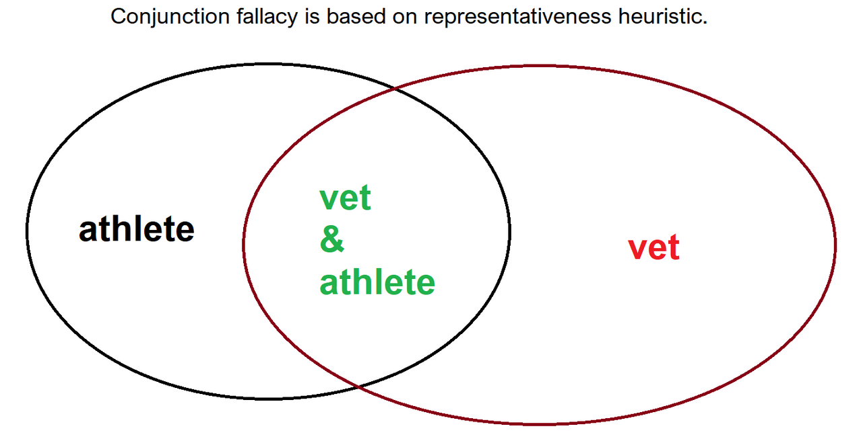
Start of chapter
Chapter 2. Illusions of thought
Beginning of the chapter
We use a Venn diagram here to show that the probability of two conjoined properties never could exceed the probability of any single of these properties.
Home
1 page back
Next
Team Latvia
Figure 16:

Slide 80
Chapter 3
Naïve realism vs scientific methods
Imagine this situation. An alarming event is happening. The person involved looks at the sky and sees a full moon shining there. At that moment, a similar event occurs in the memory, when himself or other people acted seemingly strange, and the full moon also shone. The idea arises that the full moon influences human behavior, which is also confirmed by the neighbor and the aunt. However, the protagonist of the story turns out to be quite a reasonable person, and he is doubted whether he can trust what seems "obvious".
Home
Next
1 page back

Slide 81
In order to make sure that the finding is true or false, the protagonist draws up the following action plan:
1. Introduce a journal (logbook)! Describe the behavior of specific people every day (don't trust memory)!
2. Invite others to make and record such observations (do not trust data collected by just one person)!
3. Invite others who are unaware of the purpose of the study to make behavioral observations and keep a journal (reduce the impact of leaning towards confirmation)!
4. Look for other, unaccounted factors that may influence the data and conclusions (studies of the effects of the Moon should take into account the effects of weekdays and holidays on human behavior. For three consecutive months, the full moon may fall on holidays when people behave differently)!
5. Allow skeptical, competent people, unrelated to you and your work, to search for and find mistakes and shortcomings in your work (peer review)!
Home
Beginning of the chapter
Next
1 page back
Chapter 3. Naïve realism vs scientific methods 2/5

Slide 82
Science is simply a better, less fallible way of thinking that gives more reliable results. Scientific, critical thinking differs from everyday, natural human thinking, first of all, in that it takes into account the typical mistakes of human thinking, and their impact is minimized. How to achieve this? An example of five steps is shown a few lines above! The most characteristic feature of science is the desire and ability to detect and correct mistakes, not to obtain content (Bunge, 2011).
Home
Beginning of the chapter
Next
1 page back
Chapter 3. Naïve realism vs scientific methods 3/5

Slide 83
There is one perfectly clear answer to the debate on whether or not there is a common method in science. The basic "method" in science is to reduce the impact of human thinking errors on the research process and its results. If the hypothetico-deductive method, i.e. "Scientific method" is simply a good implementation of this principle, then peer review is a universal standard in modern science, it is a necessary requirement.
Home
Beginning of the chapter
Next
1 page back
Chapter 3. Naïve realism vs scientific methods 4/5

Slide 84
Chapter 3. Naïve realism vs scientific methods 5/5
Start of chapter
Beginning of the chapter
When learning research methods, it is important that students do not associate their application with formal science alone. First, research methods need to be taught as methods to prevent specific thinking biases. Students could then adapt to applying them by testing and correcting their own experience based beliefs (Smith & Vasquez, 2008).
Any scientific activity is based on some philosophical assumptions. If they are not agreed, there is more reason to doubt the implicit assumptions on which such activity is based.
Home
1 page back
Next
Team Latvia
Scientific Thought Training Sessions

Slide 85
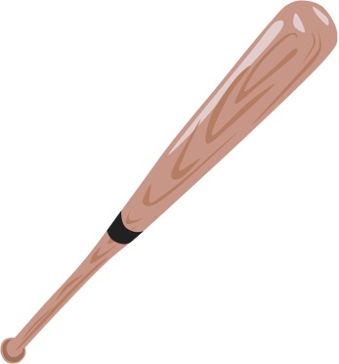
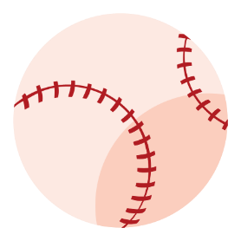
Chapter 4
Two ways of thinking. Dual process theories are helping us
Try to catch your very first thoughts regarding the result. How did they come up?
Exercise: A bat and a ball cost 1.10 Euro in total. The bat costs 1.00 Euro more than the ball. How much does the ball cost?
Why this answer?

Slide 86
Beginning of the chapter
Even if You’ve finally arrived at the correct answer, usually the first thought that pops up in our minds is “10 cents”. That is the wrong answer. The most interesting thing in all this situation is the unconscious, uncontrollable way how this wrong answer emerges. Then the next stage, that greatly defines the level of our fallibility, is whether we feel the urge not to trust our intuitions (“gut feelings”), but to switch to another way of thinking and check them thoroughly and analytically (Kahneman, 2003). Situation, when we don’t question our intuitions, is called cognitive misery or thinking laziness.
Home
1 page back
Next
Team Latvia

Slide 87
Start of chapter
Beginning of the chapter
Home
The theories describing human thinking, that have dominated the cognitive sciences and psychology in recent decades are dual process theories. They provide an account of how thought can arise in two different ways.
1 page back
Next
Team Latvia

Slide 88
Start of chapter
Beginning of the chapter
“System 1” – intuitive thinking | “System 2” – analytic thinking
Unconscious, intuitive process. Fast, effective, without any effort, thinking heuristics based, emotional. Well known errors occur relatively systematically and predictably. Implicit processes or attitudes usually take a long amount of time to change with the forming of new habits. | Conscious, controlled process. Slow, effortful, rule-based (e.g. logic), analytic, sequential thinking system. Performed in the central working memory system. Because of this, it has a limited capacity and is slower than System 1. It is known as the rational system because it reasons according to logical standards. Verbalized explicit processes or attitudes and actions may change with persuasion or education.
Home
1 page back
Next
Team Latvia
Scientific Thought Training Sessions

Slide 89
Start of chapter
Beginning of the chapter
Home
Intuitive thinking is very unreliable and erroneous on issues that are better served by scientific way of thinking, that means – most issues. Important note: It is not always the case that analytic thinking arrives at better results than intuitive!
1 page back
Next
Team Latvia

Slide 90
Start of chapter
Beginning of the chapter
There are two ways why and how that happens:
1) Analytic thinking is only as good as thinking norms used – it is normative thinking. Most of these norms are learned, many of them are plain wrong.
Home
2) One typical and counterproductive way of using analytic thinking is rationalization. Rationalization is an attempt to defend questionable thinking results obtained by intuitive thinking (or in any other way) by trying to selectively find supportive arguments.
1 page back
Next
Team Latvia
Scientific Thought Training Sessions

Slide 91
Start of chapter
Beginning of the chapter
Dual process theories – why they are so important? 1/3
Elder and Paul (1996) acknowledge that in the context of critical thinking (see Chapter 8), the most important thing for a primary school student would be to “discover” their thinking, and that this is possible only by acknowledging that thinking has “parts”, and that everyone can influence their own thinking.
Home
1 page back
Next
Team Latvia
Scientific Thought Training Sessions

Slide 92
Start of chapter
Beginning of the chapter
Dual process theories – why they are so important? 2/3
Although dual process theories do not claim the status of a precise model of human thinking, they do have an appropriate scientific basis, are easy enough to understand, and their predictable effects are demonstrable and useful in practice.
Home
1 page back
Next
Team Latvia
Scientific Thought Training Sessions

Slide 93
Start of chapter
Beginning of the chapter
Dual process theories – why they are so important? 3/3
Besides knowing typical biases of our thinking, one of the easiest ways to achieve more reliable thinking is to become aware of and overcome the problem of cognitive misery. Cognitive misery (or lazy thinking) is a tendency not to use analytic thinking, but to rely on intuitive thinking. Knowledge of theories of dual processes of thinking helps to realize and fix this problem.
Home
1 page back
Next
Team Latvia
Scientific Thought Training Sessions

Slide 94
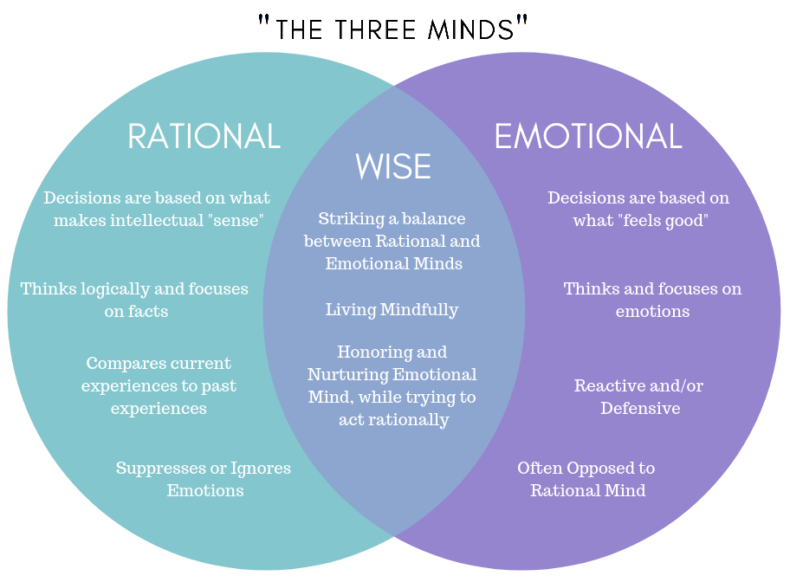
Start of chapter
Beginning of the chapter
‘‘ THE THREE MINDS ’’
Most important thing for wise living is to strike a balance between intuitive emotional and analytic rational ways of thinking.
Home
1 page back
Figure 17
Next

Slide 95
Chapter 5
Almost scientific thinking
There are four cards. Each card has a letter on one side and a number on the opposite side. Which card or cards must you turn over to verify if the following statement (hypothesis) is true: “If a card has a vowel (A, E, I… etc.) on one side, then it has an even number (2, 4, 6… etc.) on the other side”?
E
K
4
7
Check your answer!
Think this thoroughly and only then

Slide 96
Home
This is the Wason selection task. It is a logic puzzle devised by Peter C. Wason in 1966. We could verify or disprove a hypothesis. As this isn’t possible to proof a scientific theory (but only to get good evidence supporting it), one of the great philosophers of science Karl Popper insisted that a theory could have a scientific status only if it could be proved wrong. If there is no way to do this, it is not a scientific theory or hypothesis.
Next
1 page back
Scientific Thought Training Sessions

Slide 97
Beginning of the chapter
Most people tend to chose “E” and “4”. To disconfirm hypothesis we should find a card with a vowel on the one side and an odd number on the other. So for this hypothesis it doesn’t matter what is on the opposite side of the cards “4” and “K”, as it doesn’t verify or disprove anything. The right choice of cards to be overturned is “E” and “7”. If there is a consonant (say, “T”) on the other side of the card with number “4”, it is not relevant, as the hypothesis doesn’t say anything about cards with consonants.
Home
1 page back
Next
Scientific Thought Training Sessions
Team Latvia

Slide 98
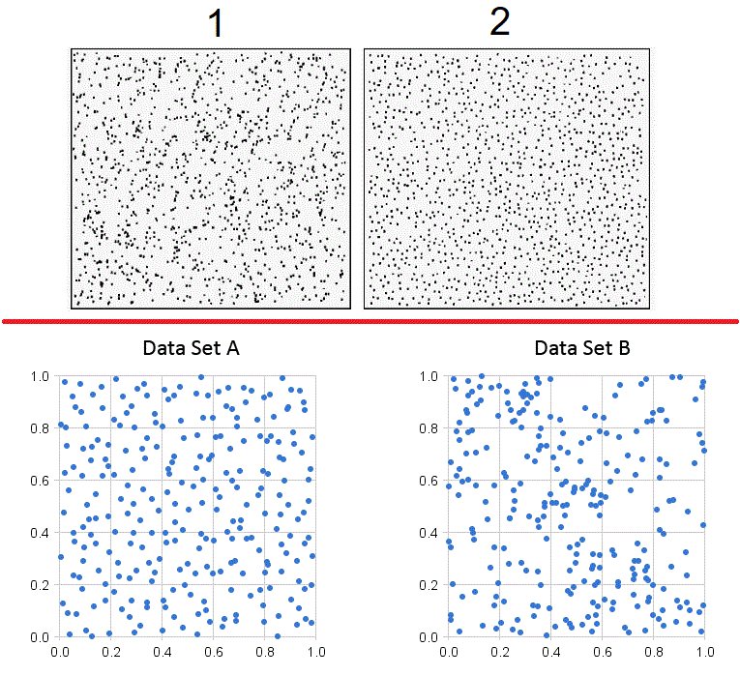
There are two pairs of fields filled with dots. Random distribution is where there is no real pattern.
Guess, where there is a random distribution of dots!
Home
1 & A
1 & B
2 & A
2 & B
Figure 18

Slide 99
Beginning of the chapter
Answer: Dots in the pictures “A” and “2” may be more evenly distributed, but this distribution is not actually random. Humans have a tendency to see patterns and structures everywhere, even where there are no real ones. Correct answer is “1 & B”. Randomly distributed data usually have some random clusters of data points. We are very prone to think about clusters as being in existence due to some special cause and not due to the random chance. The opposite is true – if there are no data clusters, it is a clear sign of not random distribution. This is where fraudulent accountants make mistakes when forging payment documents, and how authorities using data analysis could catch them.
Home
1 page back
Next
Team Latvia
Scientific Thought Training Sessions

Slide 100
Start of chapter
Beginning of the chapter
Correlation and causation.
“In the broadest sense correlation is any statistical association, though it commonly refers to the degree to which a pair of variables are linearly related”; “Essentially, correlation is the measure of how two or more variables are related to one another.” (https://en.wikipedia.org/wiki/Correlation). Two variables are independent when the value of one gives no information about the value of the other (Altman & Krzywinski, 2015).
Home
1 page back
Next
Team Latvia

Slide 101
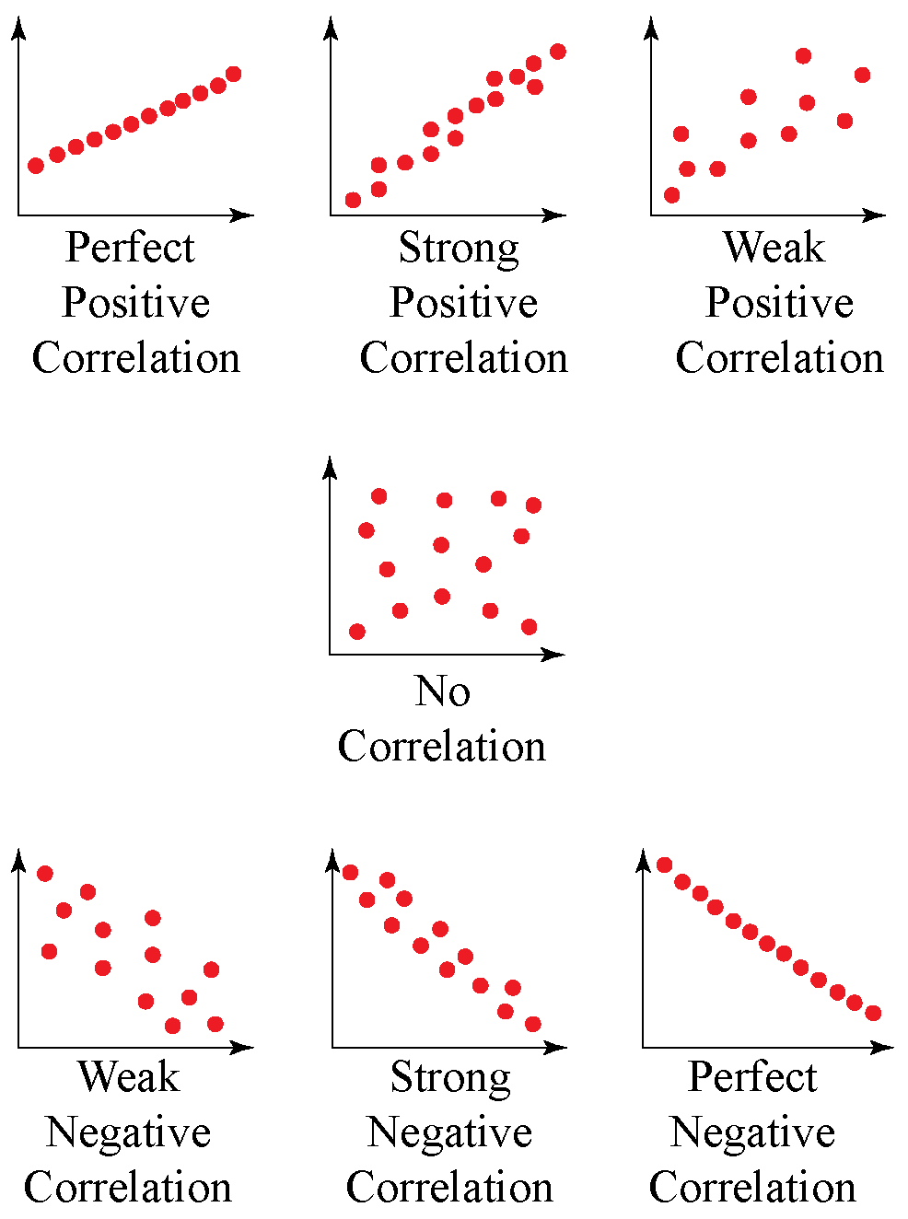
Start of chapter
Beginning of the chapter
Correlation and causation.
There could be stronger or weaker correlation, correlation between two variables could be positive or negative.
Home
1 page back
Next
Team Latvia
Figure 19

Slide 102
Beginning of the chapter
Correlation does not imply causation.
To establish causality you need to show three things:
1) that X came before Y
Home
2) that the observed relationship between X and Y didn't happen by chance alone
3) that there is nothing else that accounts for the X -> Y relationship. There are no other intervening or unaccounted for variable that is responsible for the relationship between X and Y (no alternate causes) (https://info.umkc.edu/drbanderson/establishing-causality/)
1 page back
Next
Team Latvia
Scientific Thought Training Sessions

Slide 103
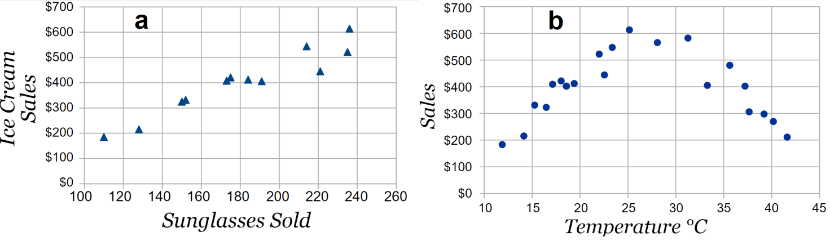
Beginning of the chapter
Figure 20
Home
In fig. 25–a we see strong linear association (correlation) between two variables, but this is not the case that ice cream sales increase is caused by larger numbers of sunglasses sold. There may be some other variable (like weather) influencing both of former variables (fig. 25–b), and, as we see, this relationship could be non-linear.
1 page back
Next
Team Latvia

Slide 104
Beginning of the chapter
Mistakenly pronounced causality usually occurs due to:
1) Lack of real association (correlation in broader sense) between variables. We are very prone to make connections between points. Not only between visual points, but also events separated by time intervals etc. We tend to notice co-occurrences of full moon and some events which happen due to chance, but do not account for non-occurrences.
Home
2) There is a correlation, but it does not imply causation X–>Y, as there is a third variable Z, that causes X and Y.
1 page back
Next
Team Latvia
Scientific Thought Training Sessions

Slide 105
Beginning of the chapter
Mistakenly pronounced causality usually occurs due to:
3) There is a correlation, but it does not imply causation X–>Y, as there is opposite causality Y causes X.
Home
4) There is a correlation, but it does not imply causation. If we have a lot of data we could find some spontaneous correlations due to randomness of data. Watch for these funny examples: http://www.tylervigen.com/spurious-correlations.
1 page back
Next
Team Latvia
Scientific Thought Training Sessions

Slide 106
Chapter 6
Figure 21
Logic
We will start with an example of logical argument sometimes attributed to Greek philosopher Aristotle (384. – 322. BCE), the key figure in the history of logic.
1. All men are mortal
2. Socrates is a man
3. Therefore, Socrates is mortal.
First two statements are called premises, third is a conclusion.
B
C
A
A – mortals
B – men
C - Socrates
Next

Slide 107
Beginning of the chapter
Chapter 6. Logic 2/9
An argument is a series of statements, called the premises, intended to determine the degree of truth of another statement, the conclusion.
“The aim of logic is the elaboration of a coherent system that allows us to investigate, classify, and evaluate good and bad forms of reasoning.”, (https://iep.utm.edu/aris-log/). Logic is reasoning conducted or assessed according to strict principles of validity.
Propositional logic have a form of statements (propositions). Argument consist of premises and conclusion. Conclusion is a statement derived from one or more initial statements – premises.
Home
1 page back
Next
Team Latvia

Slide 108
Beginning of the chapter
Chapter 6. Logic 3/9
We are discussing deductive arguments here, those where we can obtain 100% true conclusion, if conditions are right (premises are true and argument has a valid form). There is an example for to see the difference between inductive and deductive argument:
Inductive argument: The first pencil I pulled from my bag is red. The second pencil I pulled from my bag is red. Therefore, (it is likely that) all the pencils in my bag are red.
Deductive argument: The first pencil I pulled from my bag is red. All the pencils in my bag are red. Therefore, the second pencil I pull from my bag will be red, too.
Home
1 page back
Next
Team Latvia

Slide 109
Beginning of the chapter
Chapter 6. Logic 4/9
A deductive argument is said to be valid if and only if it takes a form that makes it impossible for the premises to be true and the conclusion nevertheless to be false.
There are rules of logic. Historically these rules were obtained from analyzing the practice of argumentation and critique (Bensley, 2011). Thus one advice could be not to learn all these rules, but to use some evaluative technique, like Venn diagrams (fig. 26), to try to contradict validity of an argument by finding some possible relations between premises that don’t support the conclusion.
Home
1 page back
Next
Team Latvia

Slide 110
Start of chapter
Beginning of the chapter
Chapter 6. Logic 5/9
Home
“Explicit, analytic human reasoning, in contrast to intuitive reasoning, uniformly relies on a form of validity that allows distinguishing between valid and invalid arguments based on the existence of counterexamples to conclusions.”
(Markovits, 2014, 1).
1 page back
Next
Team Latvia

Slide 111
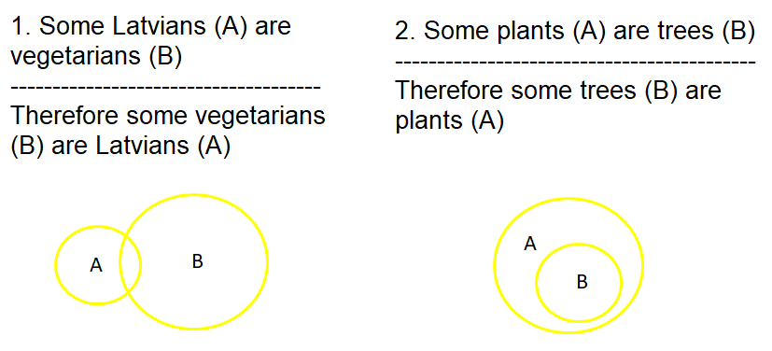
Start of chapter
Chapter 6. Logic 6/9
Beginning of the chapter
Example:
Home
Figure 22
Argument Nr. 1 (fig. 22) sounds somewhat convincing, despite being an invalid argument. With changing the premises and maintaining the form of the argument it was possible to show that this form of argument is invalid (as not some, but all trees are plants).
1 page back
Next
Team Latvia

Slide 112
Start of chapter
Beginning of the chapter
Chapter 6. Logic 7/9
Task: make some argument, consisting of two premises (with 3 concepts A, B and C in them) and a conclusion, about the topic “trees” yourself! Then try to analyze validity of it’s form by drawing Venn diagrams for all possible relations between the 3 concepts in the premises!
Home
1 page back
Next
Team Latvia
Scientific Thought Training Sessions

Slide 113
Start of chapter
Beginning of the chapter
Chapter 6. Logic 8/9
What one generally considers to be logic and logical in one's thinking is often at odds with any principles of formal logic. We are usually persuaded by arguments whose conclusion subjectively sounds plausible, regardless of its actual validity (Evans, Barston, & Pollard, 1983). Confidence in the correctness of a judgment depends on the consensuality of the conclusion, on whether it coincides with the views of the majority (Bajšanski, Žauhar, & Valerjev, 2019).
Home
1 page back
Next
Team Latvia
Scientific Thought Training Sessions

Slide 114
Start of chapter
Beginning of the chapter
Chapter 6. Logic 9/9
Because of that, and other quirks of our thinking, there are a lot of ways we fall for the lack of logic in our reasoning. And a lot of times we are elaborating on the invalid logic for to convince ourselves and others. More on that by searching for “logical fallacies”, or here:
https://yourlogicalfallacyis.com/
One of the major sources of errors, when we try to have an argumentation, is having unstated assumptions. True logical argument uses exclusively the information explicitly stated in the premises.
Home
1 page back
Next
Scientific Thought Training Sessions

Slide 115
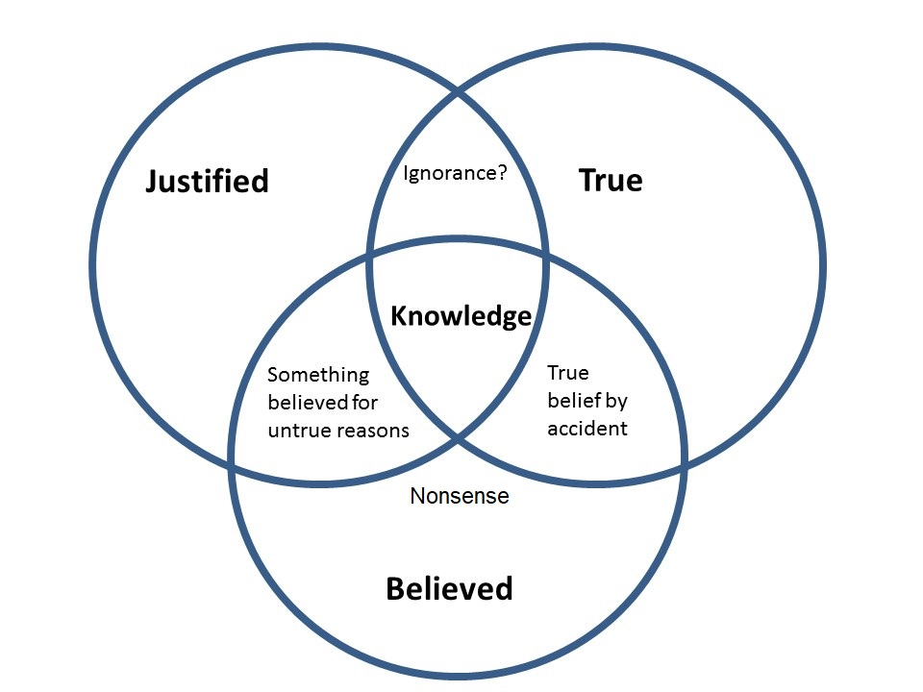
Chapter 7
Justified true belief and culture of discussion
Figure 23
We all assume that our beliefs are well justified and true, that means, they correspond to reality, to how things really are. As we showed earlier, this could not be true in all the cases, due to fallibility of our thinking. But wouldn't it be good if it were? That is why the classical definition is that knowledge is justified true belief. Despite not being a perfect definition, more being a good assumption, this is the best and most useful definition of knowledge (fig. 28) we have so far.
See, what’s going on in this cartoon , and how it is related to knowledge?

Slide 116
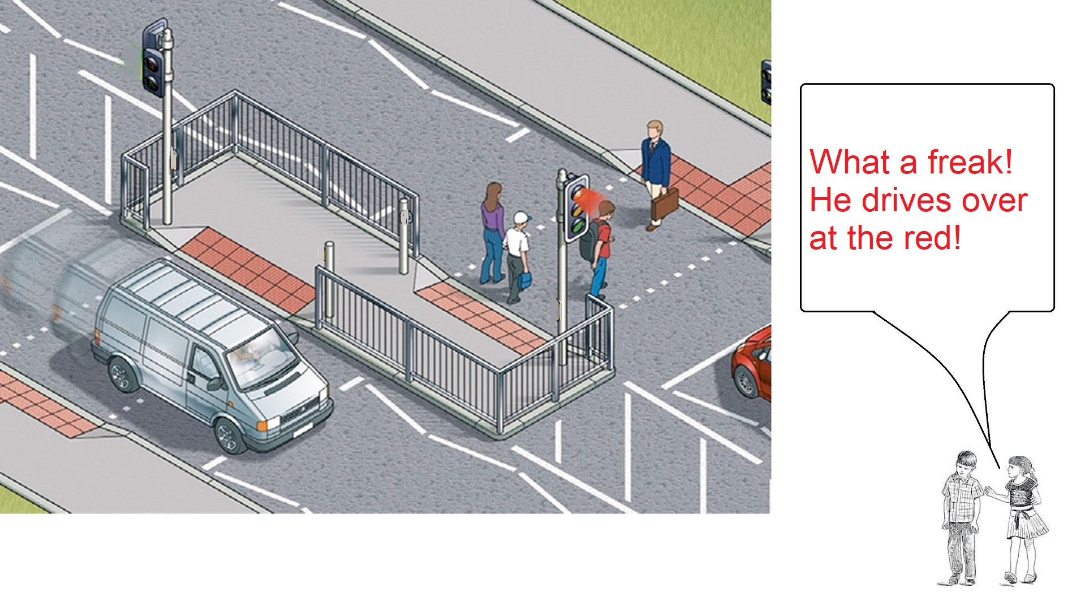
Scientific Thought Training Sessions
1 page back
Next

Slide 117
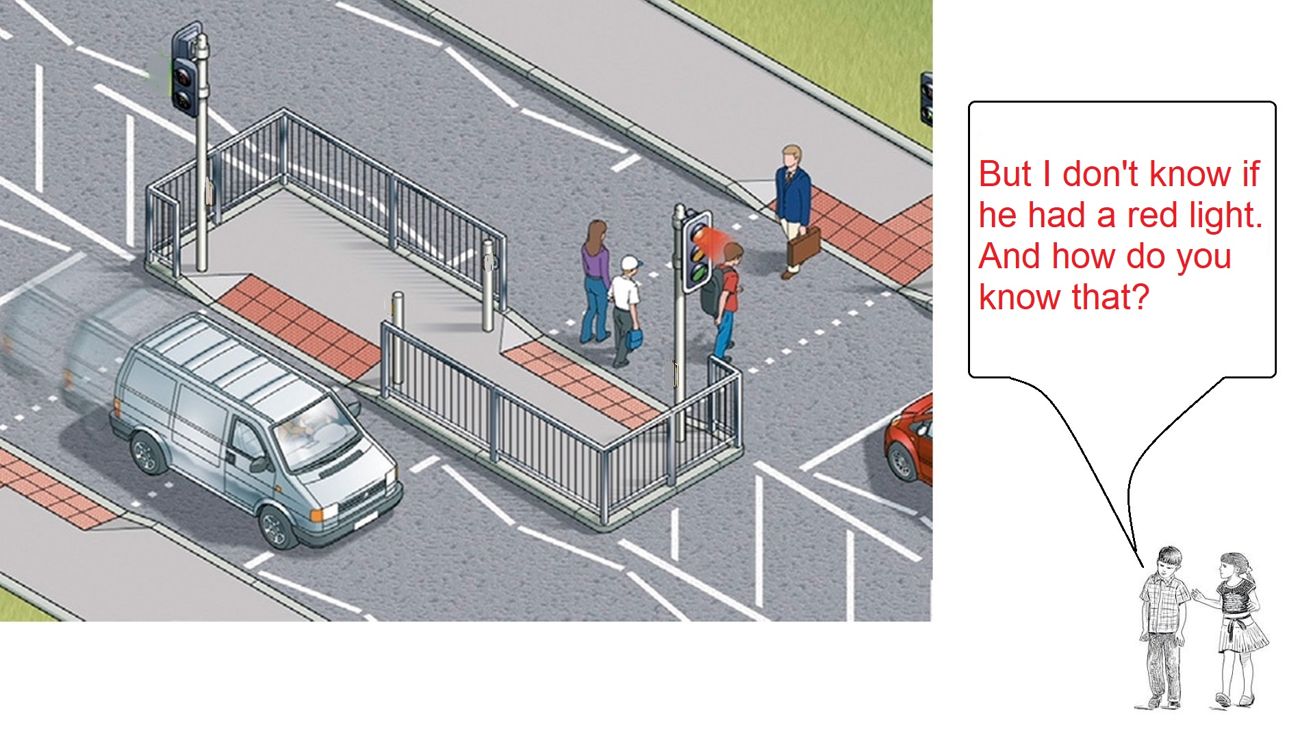
Scientific Thought Training Sessions
1 page back
Next

Slide 118
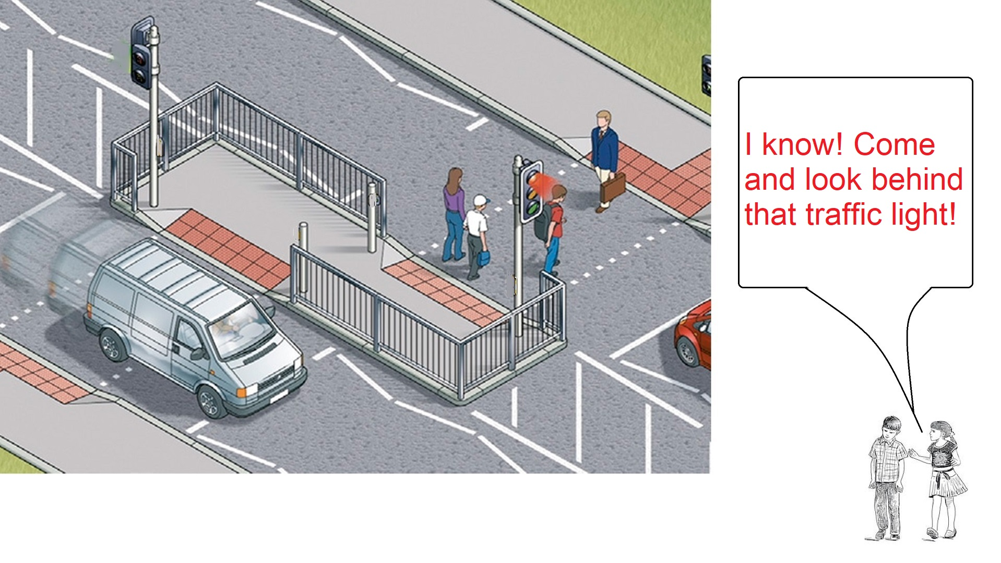
Scientific Thought Training Sessions
1 page back
Next

Slide 119
Start of chapter
Beginning of the chapter
Answer: There is a mistake of trying to divert attention from non existent justification (lack of evidence) to the hypothetical truthfulness. The answer without this mistake would be: “OK, I don’t know either. But we could try to get some evidence, if we somehow will check the timing of those lights.”
Home
1 page back
Next
Team Latvia
Scientific Thought Training Sessions

Slide 120
Start of chapter
Beginning of the chapter
Using classical philosophical definition of knowledge (as justified true belief) is a very productive way of thinking, and a good way to avoid conflicts and misunderstanding. We just have to realize and appreciate how few of what we think we know, we really know ourselves! But it is important not to dismiss the very possibility of having justified true beliefs.
Home
1 page back
Next
Team Latvia
Scientific Thought Training Sessions

Slide 121
Start of chapter
Beginning of the chapter
According to definition of knowledge as justified true belief, we can not say that John, who says that Earth is round, has better knowledge about the form of Earth, than Peter, who are trying to convince us, that Earth is flat. We have a lot of evidence, that Peter is having untrue belief. We know a lot how people are maintaining their false beliefs, falling for thinking biases. But we know nothing about whether John himself is having some justification, beyond that he is told that the Earth is round (accidentally true belief).
Home
1 page back
Next
Team Latvia
Scientific Thought Training Sessions

Slide 122
Start of chapter
Beginning of the chapter
Culture of discussion. 1/3
Home
The basic condition for a discussion to be called a discussion at all, and not a verbal altercation, is not to engage in a discussion if one cannot imagine a sufficient justification for changing one's position. Without this opportunity, there can be no question of fair consideration of alternatives.
1 page back
Next
Team Latvia
Scientific Thought Training Sessions

Slide 123
Start of chapter
Beginning of the chapter
Culture of discussion. 2/3
The rules of the Anatol Rapoport, reformulated by Daniel Denet (as quoted in Lack & Rousseau, 2016), state that before beginning to refute or criticize an opponent's opinion, one should try to reformulate it so the opponent agrees, that it is a good way to express his or her opinion, then to find something to agree with and something what can be learned from it. It is important to focus on the form and content of the opponent’s argument, not on the opponent or non related things (Foresman, Fosl, & Watson, 2016).
Home
1 page back
Next
Team Latvia
Scientific Thought Training Sessions

Slide 124
Start of chapter
Beginning of the chapter
Culture of discussion. 3/3
As a virtue and norm, one must learn to truly acknowledge one's ignorance. If you are unable to look critically at your own beliefs, your criticism of other people’s beliefs is questionable (Lack & Rousseau, 2016).
Home
1 page back
Next
Team Latvia

Slide 125
Chapter 8
Critical thinking
There is no separate, specific set of critical thinking knowledge and theories that is not a product of philosophy and science. The concept of critical thinking is relevant due to our inability to grasp the entire heritage and advancement of human knowledge, it is an attempt to form a brief insight into the most relevant elements of this heritage in the context of knowledge.
Next

Slide 126
Beginning of the chapter
Chapter 8. Critical thinking
Home
1 page back
Next
Team Latvia

Slide 127
Beginning of the chapter
Chapter 8. Critical thinking 2/7
Critical thinking theories are based on an attempt to create a filter with which to sift from the common intellectual (philosophical, scientific) heritage of humanity those theories and approaches to work with them, which would be advisable to learn first. To learn to be able to adequately assess what to believe and, in turn, what to do, and to be able to contribute to the development of humanity.
Home
1 page back
Next
Team Latvia

Slide 128
Beginning of the chapter
Chapter 8. Critical thinking 3/7
It is not enough to acquire logic, information analysis and argumentation skills in the acquisition of full-fledged critical thinking. Thus you could acquire the skills to find mistakes in other people's judgments, which are much-needed skills, but more importantly is to learn to recognize your own thinking biases. By understanding the ways in which we all systematically make mistakes in our thinking, it is possible to improve mutual understanding, tolerance and reduce prejudice.
Home
1 page back
Next
Team Latvia

Slide 129
Beginning of the chapter
Chapter 8. Critical thinking 4/7
The acquisition and regular application of critical thinking does not imply a contempt for human emotions and values based on them, as some opponents of critical thinking wrongly point out. It is important to know, to recognize, to be able to distinguish, and to understand the rational and the irrational in one's thinking. The irrational is not always related to intuitive thinking, and the rational – to conscious analytical thinking, sometimes it is the other way around. The irrational in thinking should not be eradicated, but we should be aware of and evaluate its impact.
Home
1 page back
Next
Team Latvia
Scientific Thought Training Sessions

Slide 130
Beginning of the chapter
Chapter 8. Critical thinking 5/7
The most common meanings of the word “critical” in different languages –
looking for mistakes and shortcomings,
denying,
important, necessary,
extreme,
evaluative.
Home
1 page back
Next
Team Latvia
Scientific Thought Training Sessions

Slide 131
Chapter 8. Critical thinking 6/7
Beginning of the chapter
By summarizing the corresponding definitions of different authors, the following description of critical thinking can be created (Pavlovskis, 2021):
1) Critical thinking is reflective thinking, including thinking with the aim of becoming aware and improving one's thinking and avoiding prejudice.
Home
2) Critical thinking is rational thinking, it involves logic.
3) Critical thinking is purposeful thinking - it involves changing and forming one's beliefs, reaching conclusions, and taking action.
4) Critical thinking involves honest consideration of available alternatives and adoption of different perspectives.
5) Critical thinking also includes the desire and disposition to think critically.
1 page back
Next
Team Latvia
Scientific Thought Training Sessions

Slide 132
Chapter 8. Critical thinking 7/7
Scientific thinking is the application of critical thinking in science, its purpose is to acquire knowledge.
Understanding, why and what kind of uncritical and unreasonable thinking leads to believing typical pseudoscientific statements, is one of the best indicators of the high level of critical thinking. Regrettably, even potentially lower levels of critical thinking, such as simply disagreeing with six popular pseudoscience statements (including the “I’m not sure” answer), are found in only 4.6% of university students, and this number is not having a desirable association with students' quantitative study experience ( Pavlovskis, 2021).
But this is exactly why critical thinking, scientific thinking is endeavor worth taking.
Scientific Thought Training Sessions
Beginning of the chapter
1 page back
Home

Slide 133
Team Latvia
We are three students, Reinis Araks, Kristofers Nīmanis, Ričards Liškovskis and our mentor Egmonts Pavlovskis. Together we form a 2021 season FIRST Global Challenge (first.global) team Latvia (https://first.global/2021-nations/latvia-2021/). We are affiliated with the Centre of Creative Learning “Annas 2” (tjn.lv).
About us
Home

Slide 134
The problem: Our project is oriented towards the topics of why we need critical, scientific thinking knowledge, and what kind of knowledge is most needed. The problem is that good rational, analytic thinking doesn’t come naturally. It is very problematic to distinguish between facts and nonsense, despite sometimes we have a false feeling that the opposite is true. We thought of this and ultimately picked this topic because during this season we had noticed a lot of myths and misconceptions surrounding the pandemic, and these myths can greatly affect people's health. There are a lot of other pressing issues where scientific thinking is paramount.
About the project
Home
What is the solution?

Slide 135
1 page back
The Solution: Our solution consists of an educational resource where You will be able to amaze yourself with, and learn from perceptual and thinking illusions we have, and acquire knowledge about how various peculiarities of perception and thinking affect our beliefs and how to overcome problems associated with these effects. Naïve realism and confirmation bias are pervasive issues with our thinking. We hope that by outlining and demonstrating these issues and showing some scientific solutions to them, we will help others become better thinkers for better future for everyone. The choice of body of knowledge included here is primarily inspired by and largely drawn from the research made and classes taught by our team mentor Egmonts Pavlovskis on the topics of scientific and critical thinking.
About the project
Home

Slide 136
The order of your answers was :
Brian is a veterinarian and an athlete.
Brian is a doctor.
Brian is an athlete.
Brian is a veterinarian.
Home
We have good and bad news for You!
Which one You’d like to know first?
Good
Bad

Slide 137
The order of your answers was :
Brian is a veterinarian and an athlete.
Brian is a doctor.
Brian is a veterinarian.
Brian is an athlete.
Home
We have good and bad news for You!
Which one You’d like to know first?
Good
Bad

Slide 138
The order of your answers was :
Brian is a veterinarian and an athlete.
Brian is an athlete.
Brian is a doctor.
Brian is a veterinarian.
Home
We have good and bad news for You!
Which one You’d like to know first?
Good
Bad

Slide 139
The order of your answers was :
Brian is a veterinarian and an athlete.
Brian is an athlete.
Brian is a veterinarian.
Brian is a doctor.
Home
We have good and bad news for You!
Which one You’d like to know first?
Good
Bad

Slide 140
The order of your answers was :
Brian is a veterinarian and an athlete.
Brian is a veterinarian.
Brian is an athlete.
Brian is a doctor.
Home
We have good and bad news for You!
Which one You’d like to know first?
Good
Bad

Slide 141
The order of your answers was :
Brian is a veterinarian and an athlete.
Brian is a veterinarian.
Brian is a doctor.
Brian is an athlete.
Home
We have good and bad news for You!
Which one You’d like to know first?
Good
Bad

Slide 142
The order of your answers was :
Brian is a doctor.
Brian is a veterinarian and an athlete.
Brian is a veterinarian.
Brian is an athlete.
Home
We have good and bad news for You!
Which one You’d like to know first?
Good
Bad

Slide 143
The order of your answers was :
Brian is a doctor.
Brian is a veterinarian.
Brian is a veterinarian and an athlete.
Brian is an athlete.
Home
We have good and bad news for You!
Which one You’d like to know first?
Good
Bad

Slide 144
The order of your answers was :
Brian is a doctor.
Brian is an athlete.
Brian is a veterinarian and an athlete.
Brian is a veterinarian.
Home
We have good and bad news for You!
Which one You’d like to know first?
Good
Bad

Slide 145
The order of your answers was :
Brian is a doctor.
Brian is a veterinarian and an athlete.
Brian is an athlete.
Brian is a veterinarian.
Home
We have good and bad news for You!
Which one You’d like to know first?
Good
Bad

Slide 146
The order of your answers was :
Brian is an athlete.
Brian is a veterinarian and an athlete.
Brian is a veterinarian.
Brian is a doctor.
Home
We have good and bad news for You!
Which one You’d like to know first?
Good
Bad

Slide 147
The order of your answers was :
Brian is an athlete.
Brian is a doctor.
Brian is a veterinarian and an athlete.
Brian is a veterinarian.
Home
We have good and bad news for You!
Which one You’d like to know first?
Good
Bad

Slide 148
The order of your answers was :
Brian is an athlete.
Brian is a veterinarian and an athlete.
Brian is a doctor.
Brian is a veterinarian.
Home
We have good and bad news for You!
Which one You’d like to know first?
Good
Bad

Slide 149
The order of your answers was :
Brian is a veterinarian.
Brian is a veterinarian and an athlete.
Brian is a doctor.
Brian is an athlete.
Home
We have good and bad news for You!
Which one You’d like to know first?
Good
Bad

Slide 150
The order of your answers was :
Brian is a veterinarian.
Brian is a veterinarian and an athlete.
Brian is an athlete.
Brian is a doctor.
Home
We have good and bad news for You!
Which one You’d like to know first?
Good
Bad

Slide 151
The order of your answers was :
Brian is a veterinarian.
Brian is a doctor.
Brian is a veterinarian and an athlete.
Brian is an athlete.
Home
We have good and bad news for You!
Which one You’d like to know first?
Good
Bad

Slide 152
Brian has an office in the city. He has loved animals since he was a kid. He does his work on alive species. He sometimes needs to work in emergency situations.
Now click on the third most likely answer and leave the fourth most likely answer.
Brian is a veterinarian.
Brian is an athlete.
Beginning
of the
chapter
Home

Slide 153
Brian has an office in the city. He has loved animals since he was a kid. He does his work on alive species. He sometimes needs to work in emergency situations.
Now click on the third most likely answer and leave the fourth most likely answer.
Brian is a veterinarian.
Brian is a doctor.
Beginning
of the
chapter
Home

Slide 154
Brian has an office in the city. He has loved animals since he was a kid. He does his work on alive species. He sometimes needs to work in emergency situations.
Now click on the third most likely answer and leave the fourth most likely answer.
Brian is an athlete.
Brian is a doctor.
Beginning
of the
chapter
Home

Slide 155
To go back to the Figure (x) slide, click on Figure (x).
· Figure 1: A mug
· Figure 2: "Kanizsa triangle" by Fibonacci is licensed under CC BY-SA 3.0
· Figure 3: This image is in the public domain
· Figure 4: This is a derivative of a public domain picture
· Figure 5: “Martian face viking” by NASA is in the public domain
· Figure 6: “Mars face” by NASA is in the public domain
· Figure 7: “Healing grid” Credit: George Retseck
· Figure 8: Credit: Ryota Kanai
· Figure 9: Source | Credit: Dorothy A. Kleffner and V. S. Ramachandran
· Figure 10: “Dawn HAMO Image 12” by NASA is in the public domain
· Figure 11: “Lost in Perspective” by DoubleVision is licensed under CC BY-NC-SA 4.0
· Figure 12: This work is a derivative of "Pisa tower04" by JoJan, used under CC BY-SA 3.0. The derivative is also licensed under CC BY-SA 3.0.
Next

Slide 156
To go back to the Figure (x) slide, click on Figure (x).
· Figure 13: Credit: trandoductin
· Figure 14: "Checker shadow illusion" by Edward H. Adelson, vectorized by Pbroks13 is licensed under CC BY-SA 4.0
· Figure 15: Derivative of "Checker shadow illusion" by Edward H. Adelson, vectorized by Pbroks13, used under CC BY-SA 4.0.
· Figure 16: Venn diagram clarifying conjunction fallacy
· Figure 17: https://drive.google.com/file/d/1-YD4fWTCVxWLqS59nIa1r7W437XtY8BS/view?usp=sharing
· Figure 18: Random distribution. : https://drive.google.com/file/d/148kbi8kI8r6NtM4KbrEzDXbQj6QZwJZ3/view
for Transport is licensed under Open Government Licence v3.0
Next
1 page back

Slide 157
To go back to the Figure (x) slide, click on Figure (x).
· Figure 19: Correlation. https://drive.google.com/file/d/1W23MSpW96MtQfoOTSMODA3ypzmhVl01V/view?usp=sharing
· Figure 20: Credit: mathsisfun.com
· Figure 21: Relation of the concepts in the argument shown in Venn diagram
· Figure 22: Contradicting invalid form of an argument.
· Figure 23: Knowledge as justified true belief. https://imgur.com/a/CAUBZ7j
· Figure 24 ... figure 26: Derivative of “Rules for pedestrians - rule 28” by UK Department for Transport is licensed under Open Government Licence v3.0
1 page back

